Slide 1
Creating an
Advanced Dialog Application
An in-depth look at the process
Lorin Wilde, CTO, Wilder Communications
(substituting for John Tadlock, Lead Principal Technical Architect, AT&T)
Marie Meteer, Adjunct Professor, Brandeis University
Emmett Coin, Speech Scientist and Founder, ejTalk
Introduction: K. W. (Bill) Scholz, President, NewSpeech, LLC

Slide 2

The Scenario
Notes:
Overview: A person is using a tablet to buy some clothing. They have already put a jacket in their cart and have a running total. They see a scarf that was suggested as an accessory and they are interested in it. They ask if it is in budget.
Setting:
At home completing a clothing purchase using a tablet
Has a budget management service
Has an established relationship with the virtual agent
Previously:
Added a jacket in the shopping cart
Current Activity:
Viewing a suggested scarf and considering buying it
[shot: over the shoulder of the human leading up to the human saying…]
Human: “Oh wait! Do I have enough in my budget for this one?”
[shot: close up of tablet screen and human hand then agent says …]
Virtual Agent: “Well, not if you also purchase the jacket.”
[shot: tablet screen shows jacket from cart and budget overage that would occur…]

Slide 3

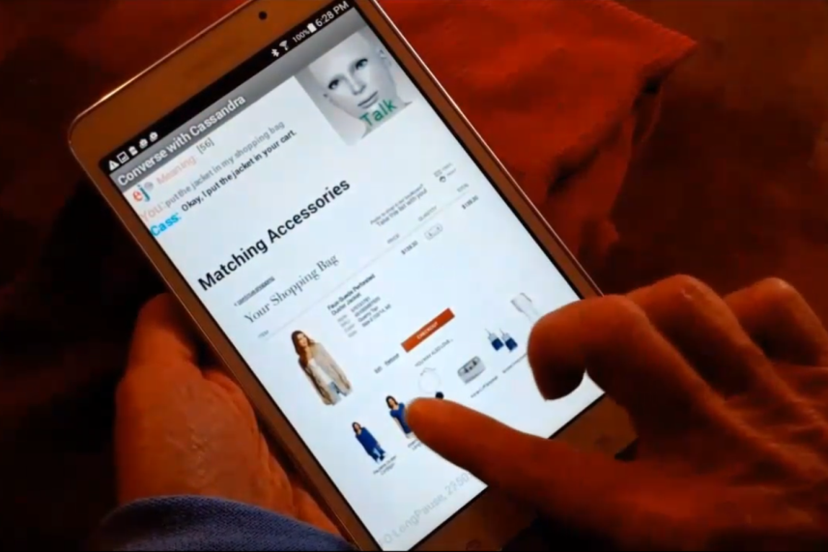
A Turn in an Advanced Dialog
discourse events
flexible topic flow
mixed initiative
pronoun resolution
multimodal input
“But wait! Do I have enough for this?”
“Not if you buy the suede jacket.”
“No, but I could show you some tops that are on sale.”
“No, but there might be some promotions. Want to look?”
“You’re $8 over, want to change the budget?”
Personal information
Problem solving
Decision point

Slide 4
A Preview of our Conclusions
Dialog decision points are strategic opportunities
  A system response takes the dialog in a particular direction and we can make that direction count
Dialog design is modular, not linear
  We multitask, our dialog systems need to as well
  The linear user interface design doc has to go
Requirements cannot be separated from design
  The words, the visuals, the data representations, and dialog management are intimately connected
Agenda:
Lorin Wilde (for John Tadlock)
  Project Development Methods
Marie Meteer
  Business Requirements
  Architectural Solution
  User Interface Design
Emmett Coin
  System Requirements
  Implementation

Slide 5
Project Development Methods

Slide 6
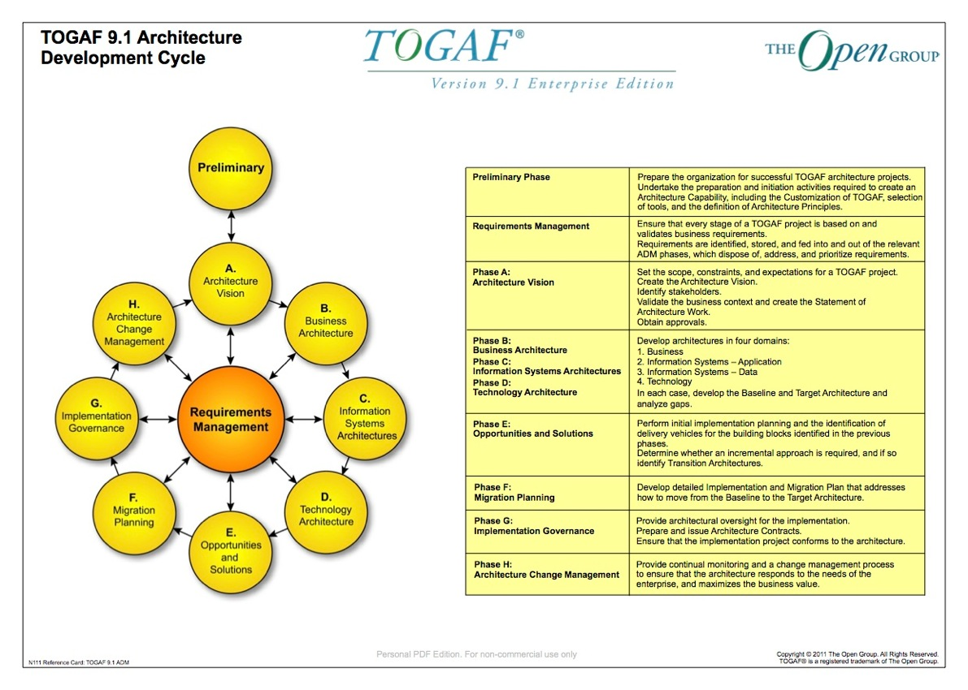
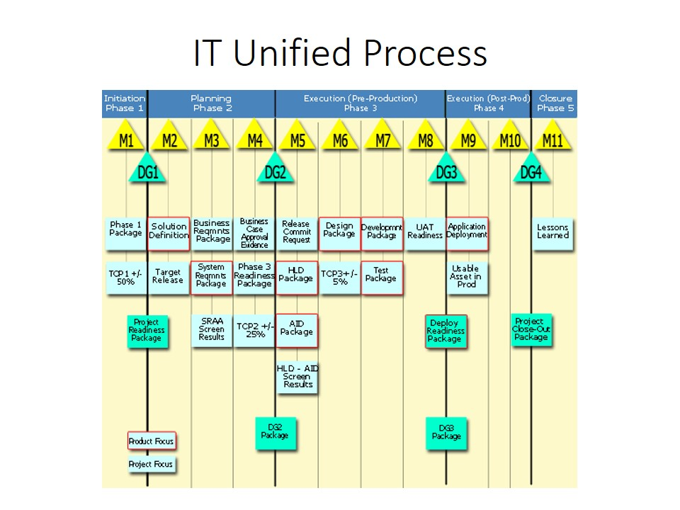
What are Project Development Methods?
Approaches for planning, designing, implementing, and governing complex projects.
TOGAF Architecture
Development Method
Why are they needed?
Manage complexity
Ensure completeness
Support an enterprise architecture
  Which supports strategy and planning
Support change and growth
Lower costs, reduces risk
Improve time to market
Corporate Methods

Slide 7

Existing Methods Typical Artifacts Produced
TOGAF Architecture
Development Method
Preliminary Project Request
Initial Architectural Solution
Early Cost Estimate
Formal Business Requirements
Detailed Architectural Solution
  System Requirements
Detailed Costs and Business Case
High Level Design
  User Interface Design
Development
Testing
Readiness Determination
Deployment
Project Close
Corporate Methods

Slide 8
Existing Methods Typical Artifacts Produced
TOGAF Architecture
Development Method
Preliminary Project Request
Initial Architectural Solution
Early Cost Estimate
Formal Business Requirements
Detailed Architectural Solution
  System Requirements
Detailed Costs and Business Case
High Level Design
  User Interface Design
Development
Testing
Readiness Determination
Deployment
Project Close
Agile
Development
Corporate Methods

Slide 9
Advanced Dialog Applications Need
Enhanced Methods and Enhanced Artifacts!
Preliminary Project Request
Initial Architectural Solution
Early Cost Estimate
Formal Business Requirements
Detailed Architectural Solution
  System Requirements
Detailed Costs and Business Case
High Level Design
  User Interface Design
Development
Testing
Readiness Determination
Deployment
Project Close

Slide 10
Advanced Dialog Applications Need
Enhanced Methods and Enhanced Artifacts!
Preliminary Project Request
Initial Architectural Solution
Early Cost Estimate
Formal Business Requirements
Detailed Architectural Solution
  System Requirements
Detailed Costs and Business Case
High Level Design
  User Interface Design
Development
Testing
Readiness Determination
Deployment
Project Close
What would these look like?
Notes:
Requires evolutionary change

Slide 11
Conclusions
Dialog decision points are strategic opportunities
  A system response takes the dialog in a particular direction and we can make that direction count
Dialog design is modular, not linear
  We multitask, our dialog systems need to as well
  The linear user interface design doc has to go
Requirements cannot be separated from design
  The words, the visuals, the data representations, and dialog management are intimately connected
Preliminary Project Request
Initial Architectural Solution
Early Cost Estimate
Formal Business Requirements
Detailed Architectural Solution
  System Requirements
Detailed Costs and Business Case
High Level Design
  User Interface Design
Development
Testing
Readiness Determination
Deployment
Project Close

Slide 12
Conclusions (and Ramification #1)
Dialog decision points are strategic opportunities
  A system response takes the dialog in a particular direction and we can make that direction count
Dialog design is modular, not linear
  We multitask, our dialog systems need to as well
  The linear user interface design doc has to go
Requirements cannot be separated from design
  The words, the visuals, the data representations, and dialog management are intimately connected
Preliminary Project Request
Initial Architectural Solution
Early Cost Estimate
Formal Business Requirements
Detailed Architectural Solution
  System Requirements
Detailed Costs and Business Case
High Level Design
  User Interface Design
Development
Testing
Readiness Determination
Deployment
Project Close
Agile
Development
Agile development needs to be extended
to apply to Business Requirements and Architecture.

Slide 13
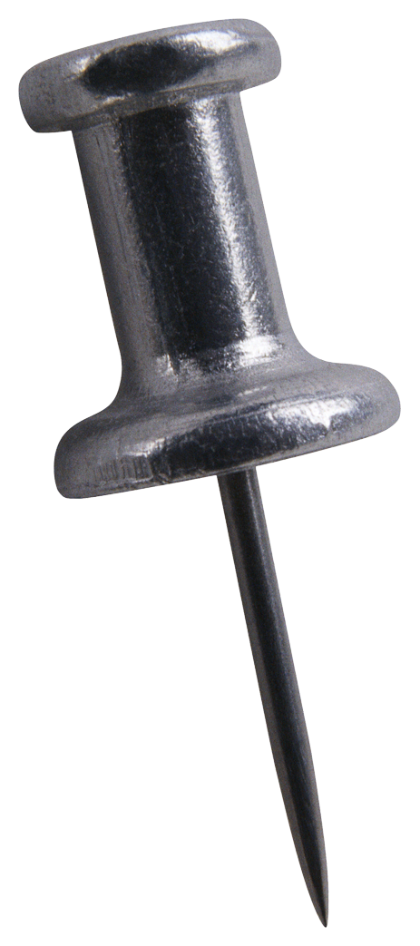

Conclusions (and Future Work)
Dialog decision points are strategic opportunities
  A system response takes the dialog in a particular direction and we can make that direction count
Dialog design is modular, not linear
  We multitask, our dialog systems need to as well
  The linear user interface design doc has to go
Requirements cannot be separated from design
  The words, the visuals, the data representations, and dialog management are intimately connected
Preliminary Project Request
Initial Architectural Solution
Early Cost Estimate
Formal Business Requirements
Detailed Architectural Solution
  System Requirements
Detailed Costs and Business Case
High Level Design
  User Interface Design
Development
Testing
Readiness Determination
Deployment
Project Close
What makes this difficult?
Iterative business requirements delay determining final costs
Often, separate organizations are responsible for Business Requirements, Architecture, and Development.
Even within Development, separate teams are responsible for separate applications.
Commonly, key aspects of the work is outsourced to vendors.
Agile
Development
“Agile” development needs to be extended to apply to Business Requirements and Architecture.
Notes:
4 points:
Evolutionary change required in Project Development Methods: Agile development needs to be extended to Business Requirements and Architecture.
1. Delay final detailed costs
2-4 Can’t silo!
4. Communication and collaboration is key: It takes advanced dialogs to build advanced dialog systems (as per our Advanced Dialog Forum – invite to join and to continue the conversation)

Slide 14
Business Requirements

Slide 15
Business Requirements for our Dialog Turn
X
“Provide a multimodal voice user interface to a catalog ordering system”
Provide a user experience on mobile devices that the allows customers to
  Browse and select products from an extensive catalog
  Comparison shop
  Manage a shopping cart
  Respect a budget provided by a financial application
Provide a user experience that
  Maximizes the value of the customer and
  brings the customer back
What makes this difficult?
How do you describe the WHAT without the HOW?
“Use cases” focus on general functionality
Need scenarios that drive advanced development
Notes:
So let’s look at how the analysis of this snippet can give us some insight into designing for the future.

Slide 16
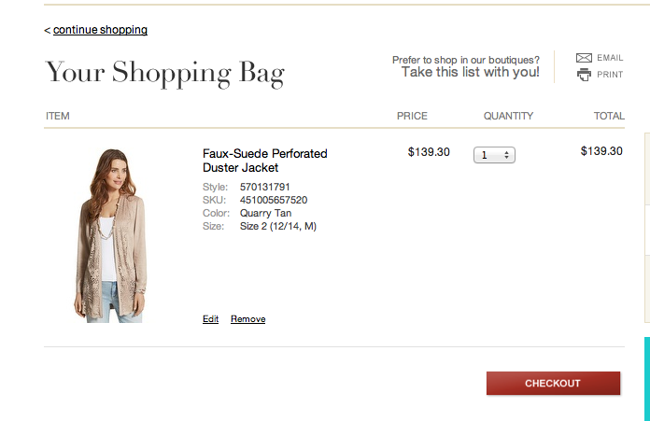
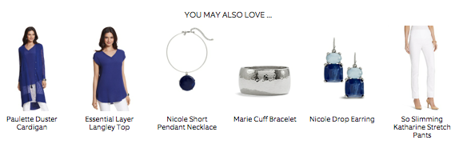
Scenario :
“I need a jacket and I don’t want to spend more than $200.00.”
Dialog so far results in the choice of jacket.
You may also love opens up new opportunities.
“Oh, show me the blue top.”

Slide 17
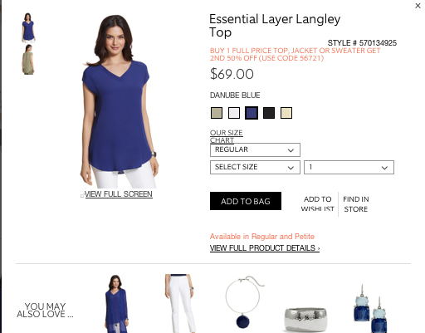
Scenario:
The Key Moment
Select Jacket
Opportunity
Check
out
“But wait! Do I have enough in my budget for this one?”
What should the response be?
Notes:
Change in business requirements means change in the response.

Slide 18
Scenario:
The Key Moment
Select Jacket
Opportunity
Check
out
But wait
Do I have enough
in my budget
for this one
What should the response be?
Recognize discourse clue
Connect the question
with the app (budget management)
Identify the object and Pick out the appropriate facet ($$$)
How to make the most of this opportunity?
Notes:
Change in business requirements means change in the response. Need to focus not on what CAN happen, but what SHOULD happen

Slide 19
From a dialog management point of view
Where would alternative replies lead the dialog?
  Not if you buy the Suede jacket.
  No, you will be $8.00 over budget
    Is that OK?
    There are some promotions available. Let me check whether one would apply.
  No, but we have some similar tops on sale.
    Would you like to see those?
A dialog manager needs to determine which direction
  Best matches the goals of the user
  And best matches the business requirements
What makes this difficult?
User goals need to be identified and tracked
Business requirements need to be translated so they can guide dialog choices
Notes:
Subtle changes in business requirements lead to different responses

Slide 20
Principles (and Ramification #2)
Dialog decision points are strategic opportunities
  A system response takes the dialog in a particular direction and we can make that direction count
Dialog design is modular, not linear
  We multitask, our dialog systems need to as well
  The linear user interface design doc has to go
Requirements cannot be separated from design
  The words, the visuals, the data representations, and dialog management are intimately connected
Select Jacket
Opportunity
Check
out
Dialog management and customer management are intimately connected

Slide 21
Architectural Solution

Slide 22
Dialog and Task Flow
Search/select category
View alternatives
View item
Put in Shopping Bag
Check out
`
We think of a task as a sequence of steps
But wait!
  The task flow allows loops and repetitions
  Each box can be multiple “turns” in the dialog
  Can leave a box, then need to return to the same place in that box
Lots of possible paths, but
  Not all paths are possible
  Not all are equally likely
  Not all meet users goals and business requirements

Slide 23
Dialog is doing.
It’s not what to say next, but what to do next
Shopping
Set up budget
Check budget
Tasks
Buy Jacket
Shop more
Search
Select
View top
No
Put in cart
But wait!
Remove jacket
Take out of cart
Put in cart
Change budget
Possible next
actions
Check out
View more
Shop for a different top
Check budget
Change budget
Shop more
Shop
View Cart
Notes:
Organize the past by tasks, organize the future by

Slide 24
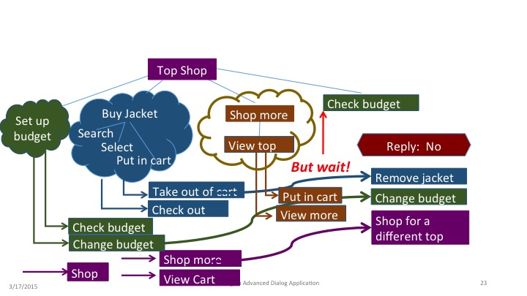
Conclusions (and Ramification #3)
Dialog decision points are strategic opportunities
  A system response takes the dialog in a particular direction and we can make that direction count
Dialog design is modular, not linear
  We multitask, our dialog systems need to as well
  The linear user interface design doc has to go.
  Task based organization is required for effective dialog management
Requirements cannot be separated from design
  The words, the visuals, the data representations, and dialog management are intimately connected
Dialog design needs to be driven by the “doing” not the sequence of “saying”

Slide 25
User Interface Design

Slide 26
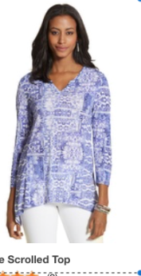
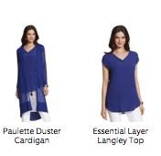


The representation, both in the dialog and in the underlying data, is critical
Show me the purple one
Show me the blue top
  People have different vocabularies for color and objects
  The product features in the database need to include color and variants
Show me the purple one
  “One” refers to an object in the context
  There are only two images on the screen—one has to fit the description
Go back to the print
  History has to track objects and descriptions
  Description can change to differentiate objects
Dialog Voice In/Out
Show me the blue top.
Go back to the print
Backend Task Execution
Screen Image and Touch
Notes:
The NL interface cannot be developed in isolation from the rest of the application
The dialog manager is managing the task flow, not just the dialog flow
The description of objects, both by the caller and the system, are tied to the visual image and the users mental categorization of the object
The underlying representation of the object must reflect the words people use to refer to objects

Slide 27
Dialog can’t be an appendage built by the speech guys
Dialog Manager
How we talk about them
How we see them
The things in the world
The Speech Guys
Voice
Data
Clicks
Speech Recognition
Natural
Language
Understanding
Dialog Manager
App
App Developers
Web/GUI Builders
Speech Synthesis (TTS)
Natural Language Generation
Voice
Text
Images
Highlighting
Notes:
What does the dialog representation / language require of the underlying object representation?
Simplest example of this is when referring to people with a pronoun, the gender of that person has to be represented
Representation of products need to have the visible and typical facets of that object explicitly represented
If color is not explicitly represented, can’t ask “How much are the brown ones?”

Slide 28
Conclusions (and Ramification #4)
Dialog decision points are strategic opportunities
  A system response takes the dialog in a particular direction and we can make that direction count
Dialog design is modular, not linear
  We multitask, our dialog systems need to as well
  The linear user interface design doc has to go
Requirements cannot be separated from design
  The words, the visuals, the data representations, and dialog management are intimately connected
What makes this difficult?
Silos
The people that build the app, design the interface, and design the dialog all
  Work in different organizations
  Use different vocabularies
<add a diagram or graphic
that illustrates the ramification>
Dialog cannot be done “After the fact”. The design cannot be separated from implementation

Slide 29
System Requirements
One possible approach
What might we need?
Notes:
The previous speakers talked about desirable and inevitable functionality that is just over the technology horizon. Clearly in order to build things like this we will need more sophisticated methodologies. In the following section I will talk about how to approach an actual implementation. I'll show one way to think about implementing this scenario.

Slide 30
System Requirements
Issues: Latency, MM, Platform, Hardware and Services
Input
  Speech[ASR] -> Semantics[NLU] -> Dialog[Conversation Management]
  Touch[deictic, gesture] -> Semantics[contextual] -> Dialog[CM] -> Resp[TTS, Display]
  Is it Platform provided? 3rd party? Stream? Batch? …
Process
  Semantics[Understand] NLP/NLU, Context, Relevance, Appropriateness
  Dialog Conversation Management: Declarative, OO, platform agnostic, MM integration
  Data
    Contextual[anaphora, previous action]
    DB[catalog, cart, budget] select, sort; RESTful API
  Scope Single/Multi store? Relationship span? Linguistic register? …
Output
    Response Modes[TTS, audio, video, images, text, vibration, etc.] Quality vs. speed/cost
Performance
    Time[sub-second cycle time e.g. “end of speech” to “display of item”]

Slide 31

Implementation: A Functional Prototype
Notes:
Overview: Working prototype showing a person with a tablet buying clothing. A jacket is already in their cart. A blue top was suggested as an accessory and they are interested in it. They ask if it is in budget.
Setting:
At home completing a clothing purchase using a tablet
Has a budget management service
Has an established relationship with the virtual agent
Previously:
Added a jacket in the shopping cart
Current Activity:
Viewing a suggested scarf and considering buying it
[shot: over the shoulder of the human leading up to the human saying…]
Human: “Oh wait! Do I have enough in my budget for this one?”
[shot: close up of tablet screen and human hand then agent says …]
Virtual Agent: “Well, not if you also purchase the jacket.”
[shot: tablet screen shows jacket from cart and budget overage that would occur…]

Slide 32




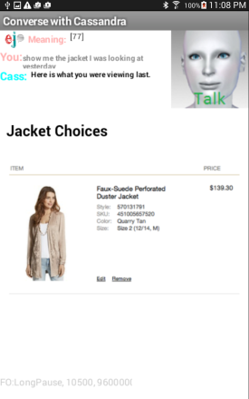
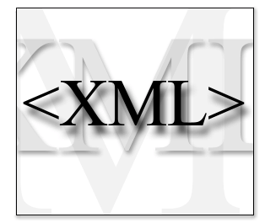
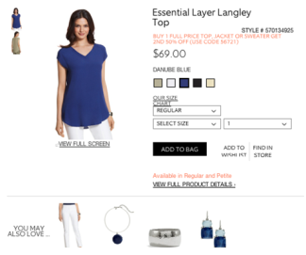

This Implementation: Tech and Tools
[Things used for this prototype]
Platform:
  Android [phone, tablet]
    Speech [Google cloud ASR, device based TTS]
    ejTalk Android client, MIT AI2 based [browser-like UI]
    Conversation Management in the cloud engine
Data Access (cart, catalog, financial, images)
  XML database suitable for direct/built-in ejTalk access
Interaction Scope (store, product type, anything)
  Single clothing/accessory online store selling women’s apparel
  Focus on the “Wait, do I have enough for this?” turn
Dialog Design Formalism: ejTalk engine
    Graphic and text-based Declarative development tool
    Encapsulate the Speech, NLU, tactile I/O, context, db, etc. elements
    Runtime interpretation/execution of the language

Slide 33
The Client Side
AI2 [MIT AppInventor 2]
  Manage input/output technologies
  Pack inputs & transmit to cloud engine
  Unpack responses from cloud & present to user
Detect touch input [via AI2 HTML]
Process speech input
  Start/Stop cloud ASR
  Gather utterance result
Present responses to TTS, HTML display, sound, etc.

Slide 34
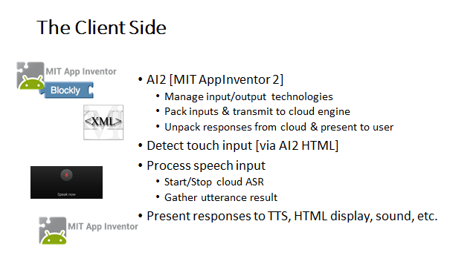
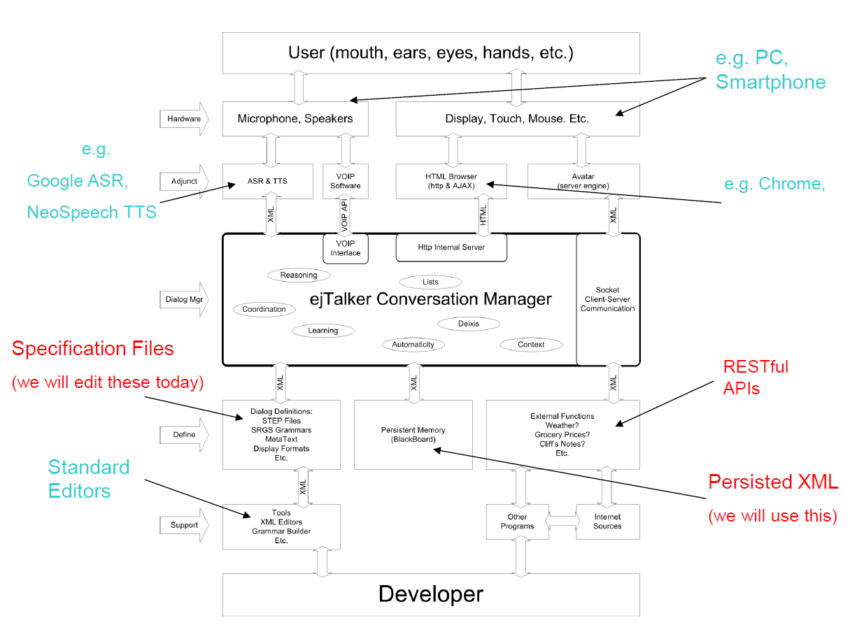
The Cloud Engine
Dialog Manager
How we talk about them
How we see them
The things in the world
The Speech Guys
App Developers
Web/GUI Builders

Slide 35

The Cloud Engine
Modified HTTP server supporting ejTalk Engine
  Communicate with the client side
  Only XML strings between Server & Client
  ejTalk Engine [Execute conversation definition]
  Process inputs for understanding
    Words, Semantics, Context
  Shift the Domain focus
    Was “looking” now “buying”
  Remember relevant context
    Implicit & Explicit
  Generate response directives
    Speech, Text, Sound, Video, Avatar, HTML display, etc.

Slide 36
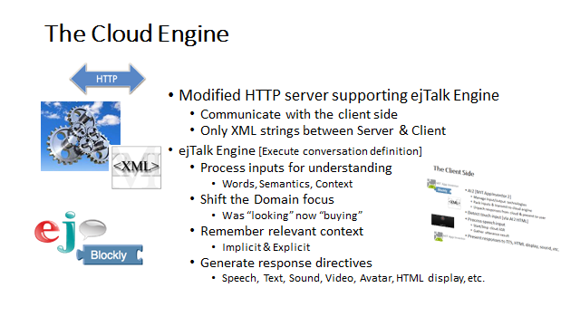
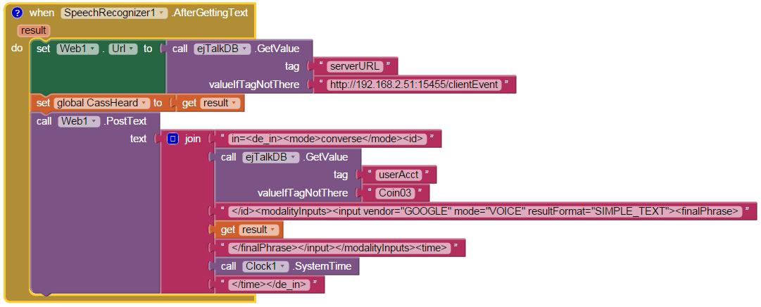
Client: Get ASR Result [AI2 code]
AI2: ASR Event Handler
Prep URL for Cloud Server
Assemble & Transmit

Slide 37
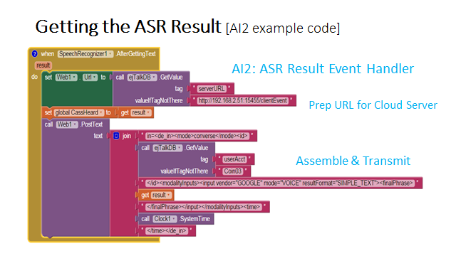
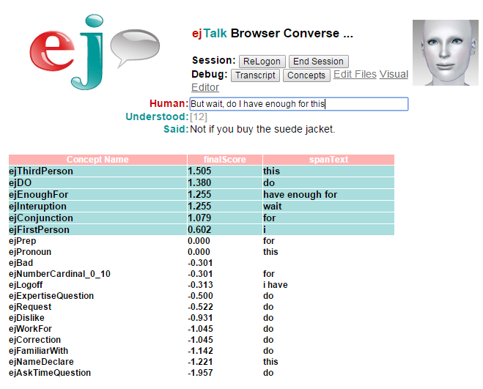
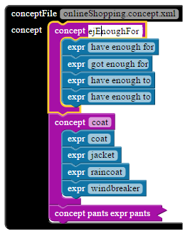
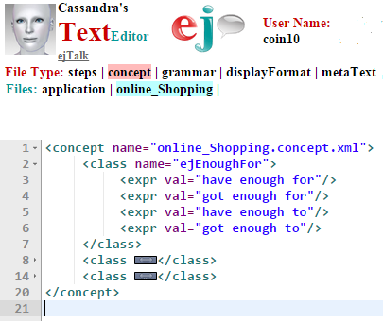
Cloud: Extract Concepts[ejTalk code]
Blockly “Concepts”
Engine Extracts Concepts
XML for Engine

Slide 38
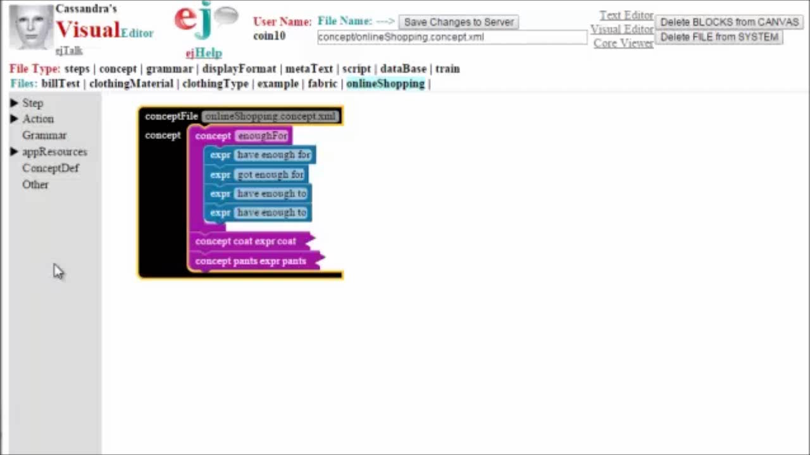
Very Quick Look at Blockly
See Notes
Notes:
Overview: A person is using a tablet to buy some clothing. They have already put a jacket in their cart and have a running total. They see a scarf that was suggested as an accessory and they are interested in it. They ask if it is in budget.
Setting:
At home completing a clothing purchase using a tablet
Has a budget management service
Has an established relationship with the virtual agent
Previously:
Added a jacket in the shopping cart
Current Activity:
Viewing a suggested scarf and considering buying it
[shot: over the shoulder of the human leading up to the human saying…]
Human: “Oh wait! Do I have enough in my budget for this one?”
[shot: close up of tablet screen and human hand then agent says …]
Virtual Agent: “Well, not if you also purchase the jacket.”
[shot: tablet screen shows jacket from cart and budget overage that would occur…]

Slide 39
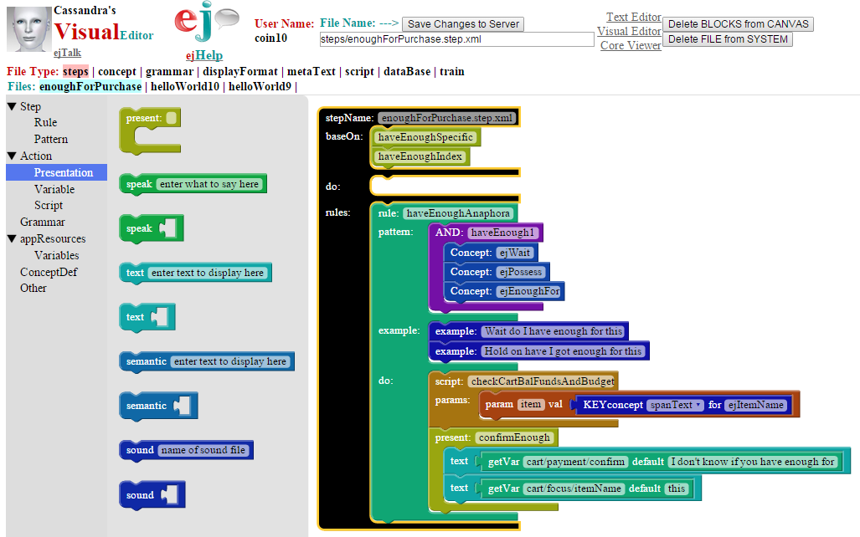
Capture the “Do I have enough” event

Slide 40
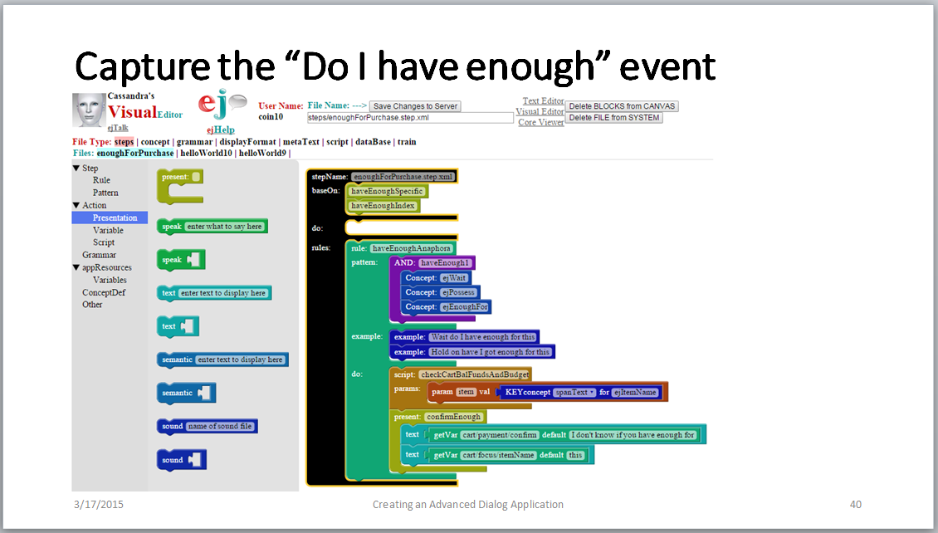
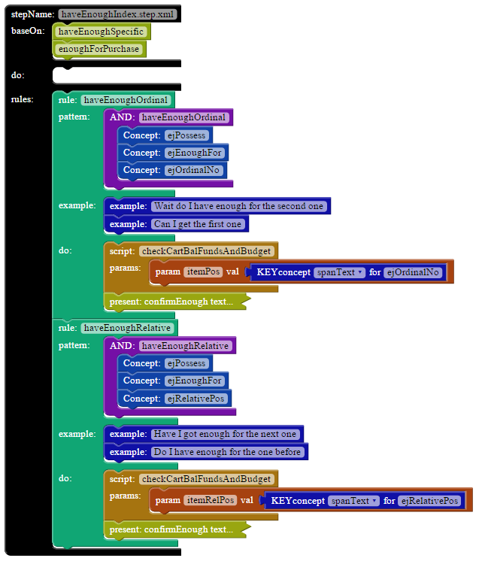
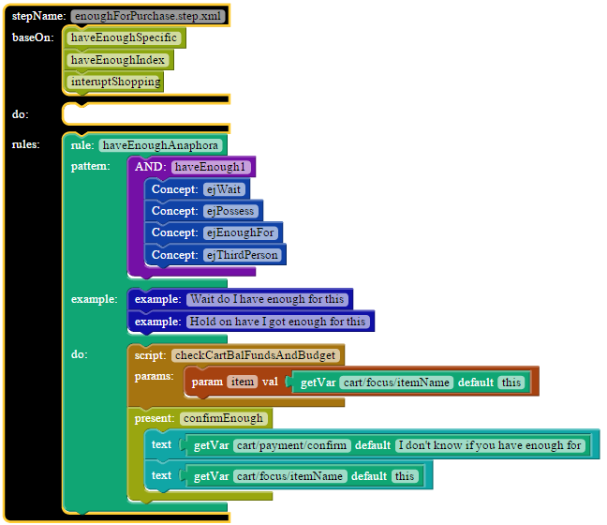
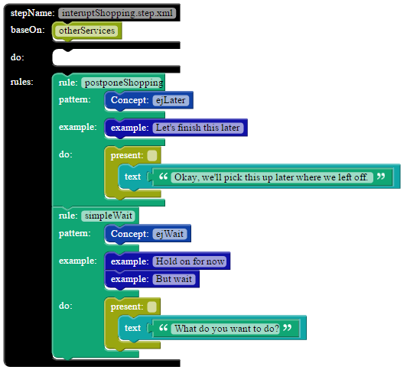
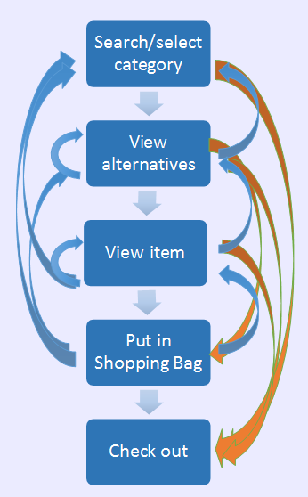
Build on Existing Functionality

Slide 41
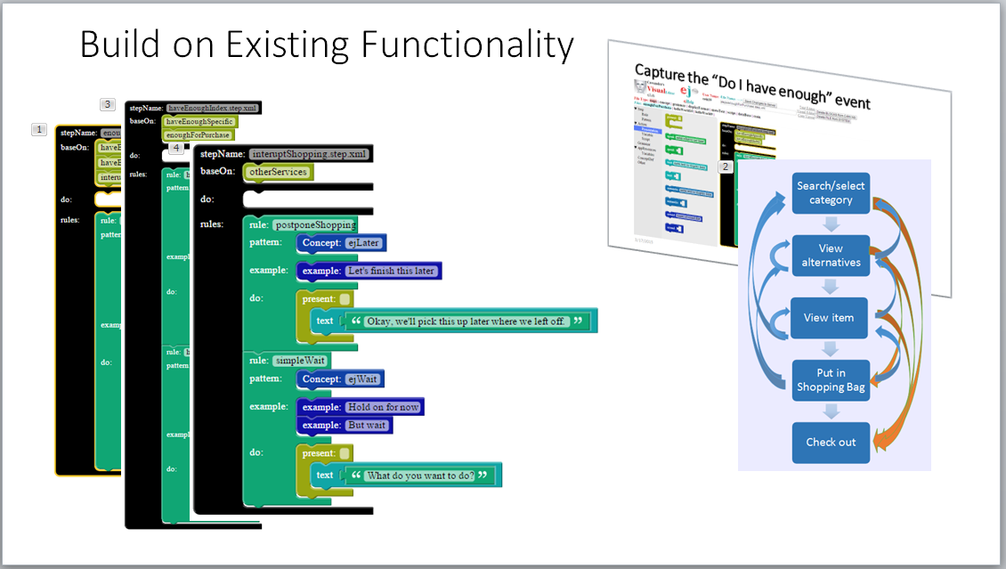
The Challenge: How to…
How to define functionality in clear and open terms
  Modular components
  Interoperable modalities
  Infinite pathways
Maximize reuse
  Minimize development EFFORT
  Maximize CONSISTENCY
Leverage automaticity
  Requires TRUST
  Necessary for naturalness
New Dialog Tech Issues:
Naturalness is non-linear (only predictable short-term)
Multi-task dialog -> IVR Multi-thread -> Single-thread
Business wants MAX control
But, Automaticity means: Delegation of control

Slide 42
Conclusions (and Ramification #5)
Dialog decision points are strategic opportunities
  We are building an encounter not a call flow
Dialog design is modular, not linear
  Multitasking dialogs will need new formalisms
  Concise flow charts of the experience are now longer possible
Requirements cannot be separated from design
  The words, the visuals, the data representations, and dialog management (response time, accuracy, adaptation) will be tethered to the available technology.
  Tech choices propagate back to the business case
What makes this difficult?
New tools are needed
Tighter coupling of the “idea to product” cycle
The product will be more autonomous
Subtle but different
Revolutionary not evolutionary
<add a diagram or graphic
that illustrates the ramification>
The technology that a user experiences as well as the tools used to build the experience both constrain the behavior possible.
Defining this new kind of experience will inevitably lead to new paradigms and formalisms.

Slide 43
Final Comments
Decision points are strategic opportunities
Dialog design is modular, not linear
Requirements cannot be separated from design
Conclusions:
Agile development extends across Business Requirements and Architecture.
Dialog management and customer management are intimately connected
Dialog design needs to address “doing”, not just “saying”
Dialog design cannot be separated from implementation
Technology and Tools used to build experience constrain the possible behavior
This new kind of experience will lead to new paradigms and formalisms
Today there is no manageable formalism to define large, context-driven conversations

